Slide 1



Intro
Advanced lifecycle email marketing strategy for IQOS
Prepared BY Xola dos Santos
DATE: 25 May 2020

Slide 2

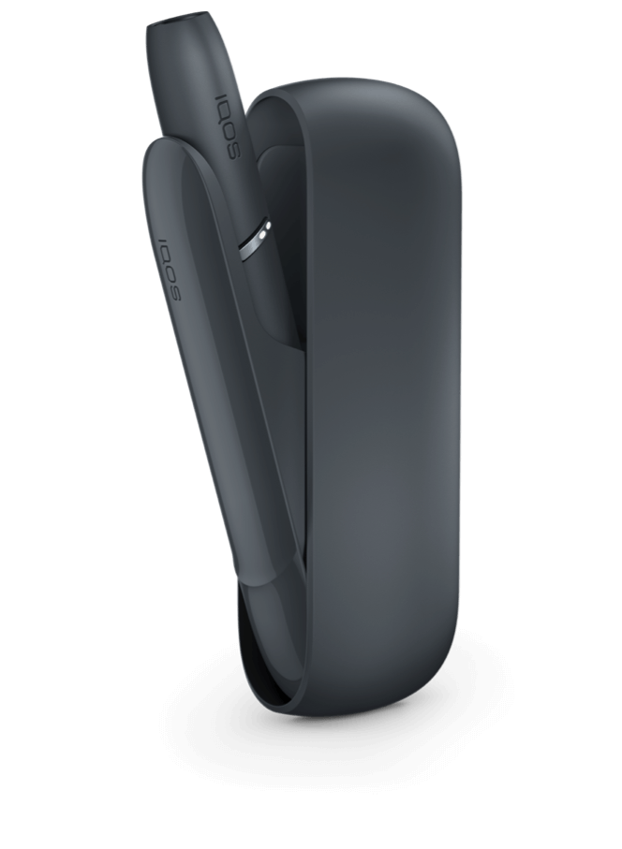

Automation Strategy for IQOS
Advanced lifecycle email marketing strategy for IQOS
This documents describes how I would identify, analyse and tackle problems in PMI’s email automation campaigns (records, processes, data etc.) using Salesforce’s toolbox of modern CRM widgets and dashboards. All insights and ideas are based on industry expertise as well as recent research I have done on PMI as part of the recruitment process.
This presentation was prepared as a simulation exercise during the Digital Marketing Automation Executive talent acquisition process.
- Xola dos Santos, Cape Town, 2020
Next

Slide 3
Overview of Software Development Life Cycle
Go-to-Market Email Strategy
Introduction
Growth
Maturity
Decline
Sales
Acquisition
Up-sell. Promote Complementary products
Retention emails
Win back mails
Epic 2
Epic 1
Epic 3
Time

Slide 4

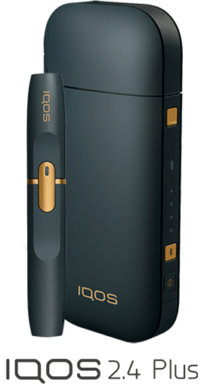

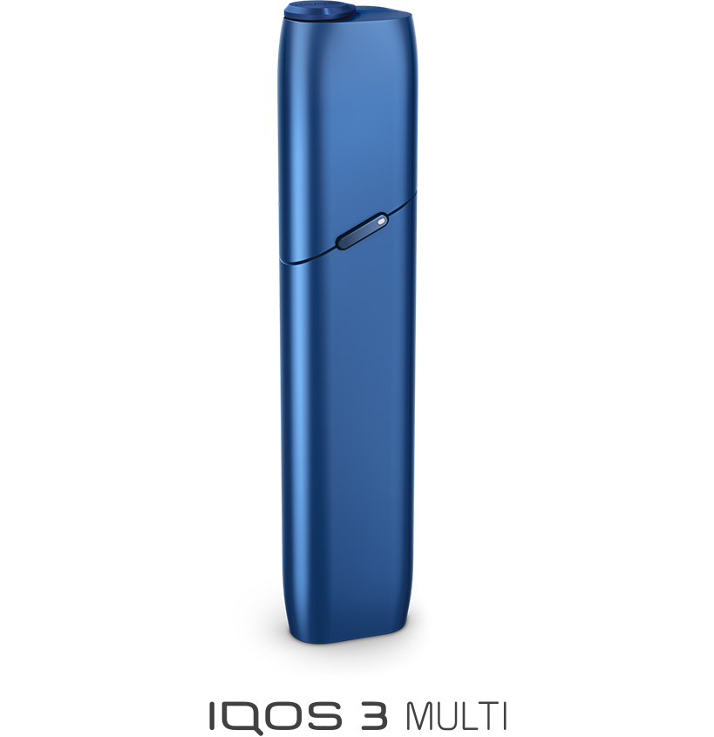
Overview of Software Development Life Cycle
Selling Products
Competitor Offering
Marketing is what brings PMI closer to their customers. Through the various existing innovative marketing campaigns we can see the marketing team is engaging with the market.
Lifecycle email marketing integrates PMI’s email database and ecommerce to generate highly personalised messages to our customers. It’s an incredibly important foundation to the customer journey in sales and marketing. Here our aim is to identify how customers move from just knowing about our product offering ( through research and referrals), to following up, purchase, join loyalty programme etc.
Our Product
Flagship
Offering
Analogue Product

Slide 5
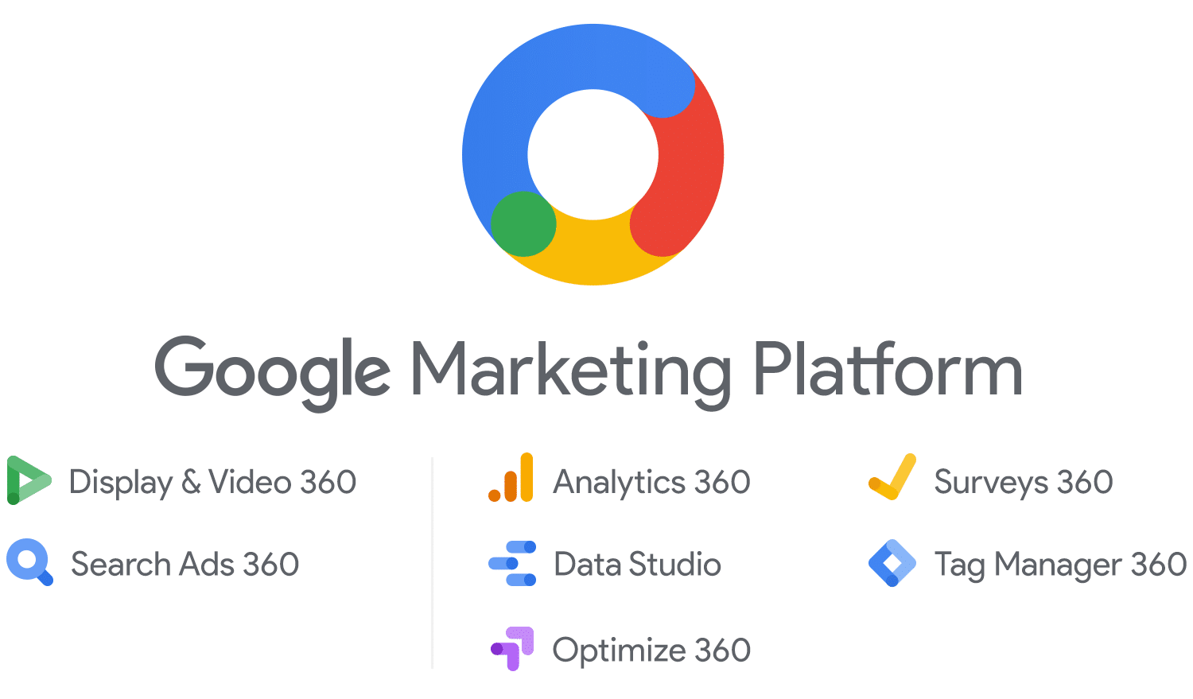
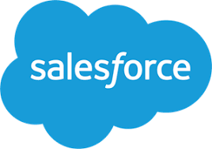
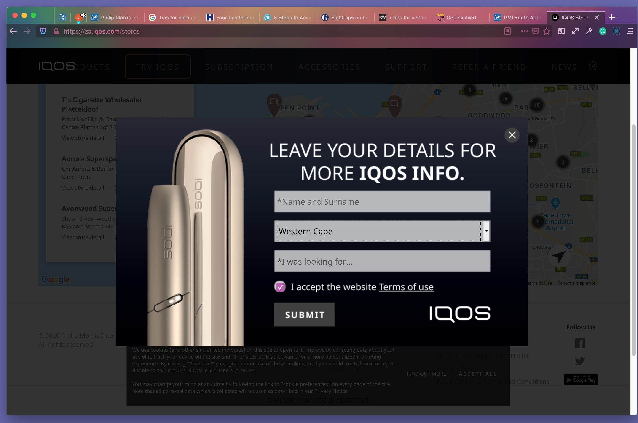
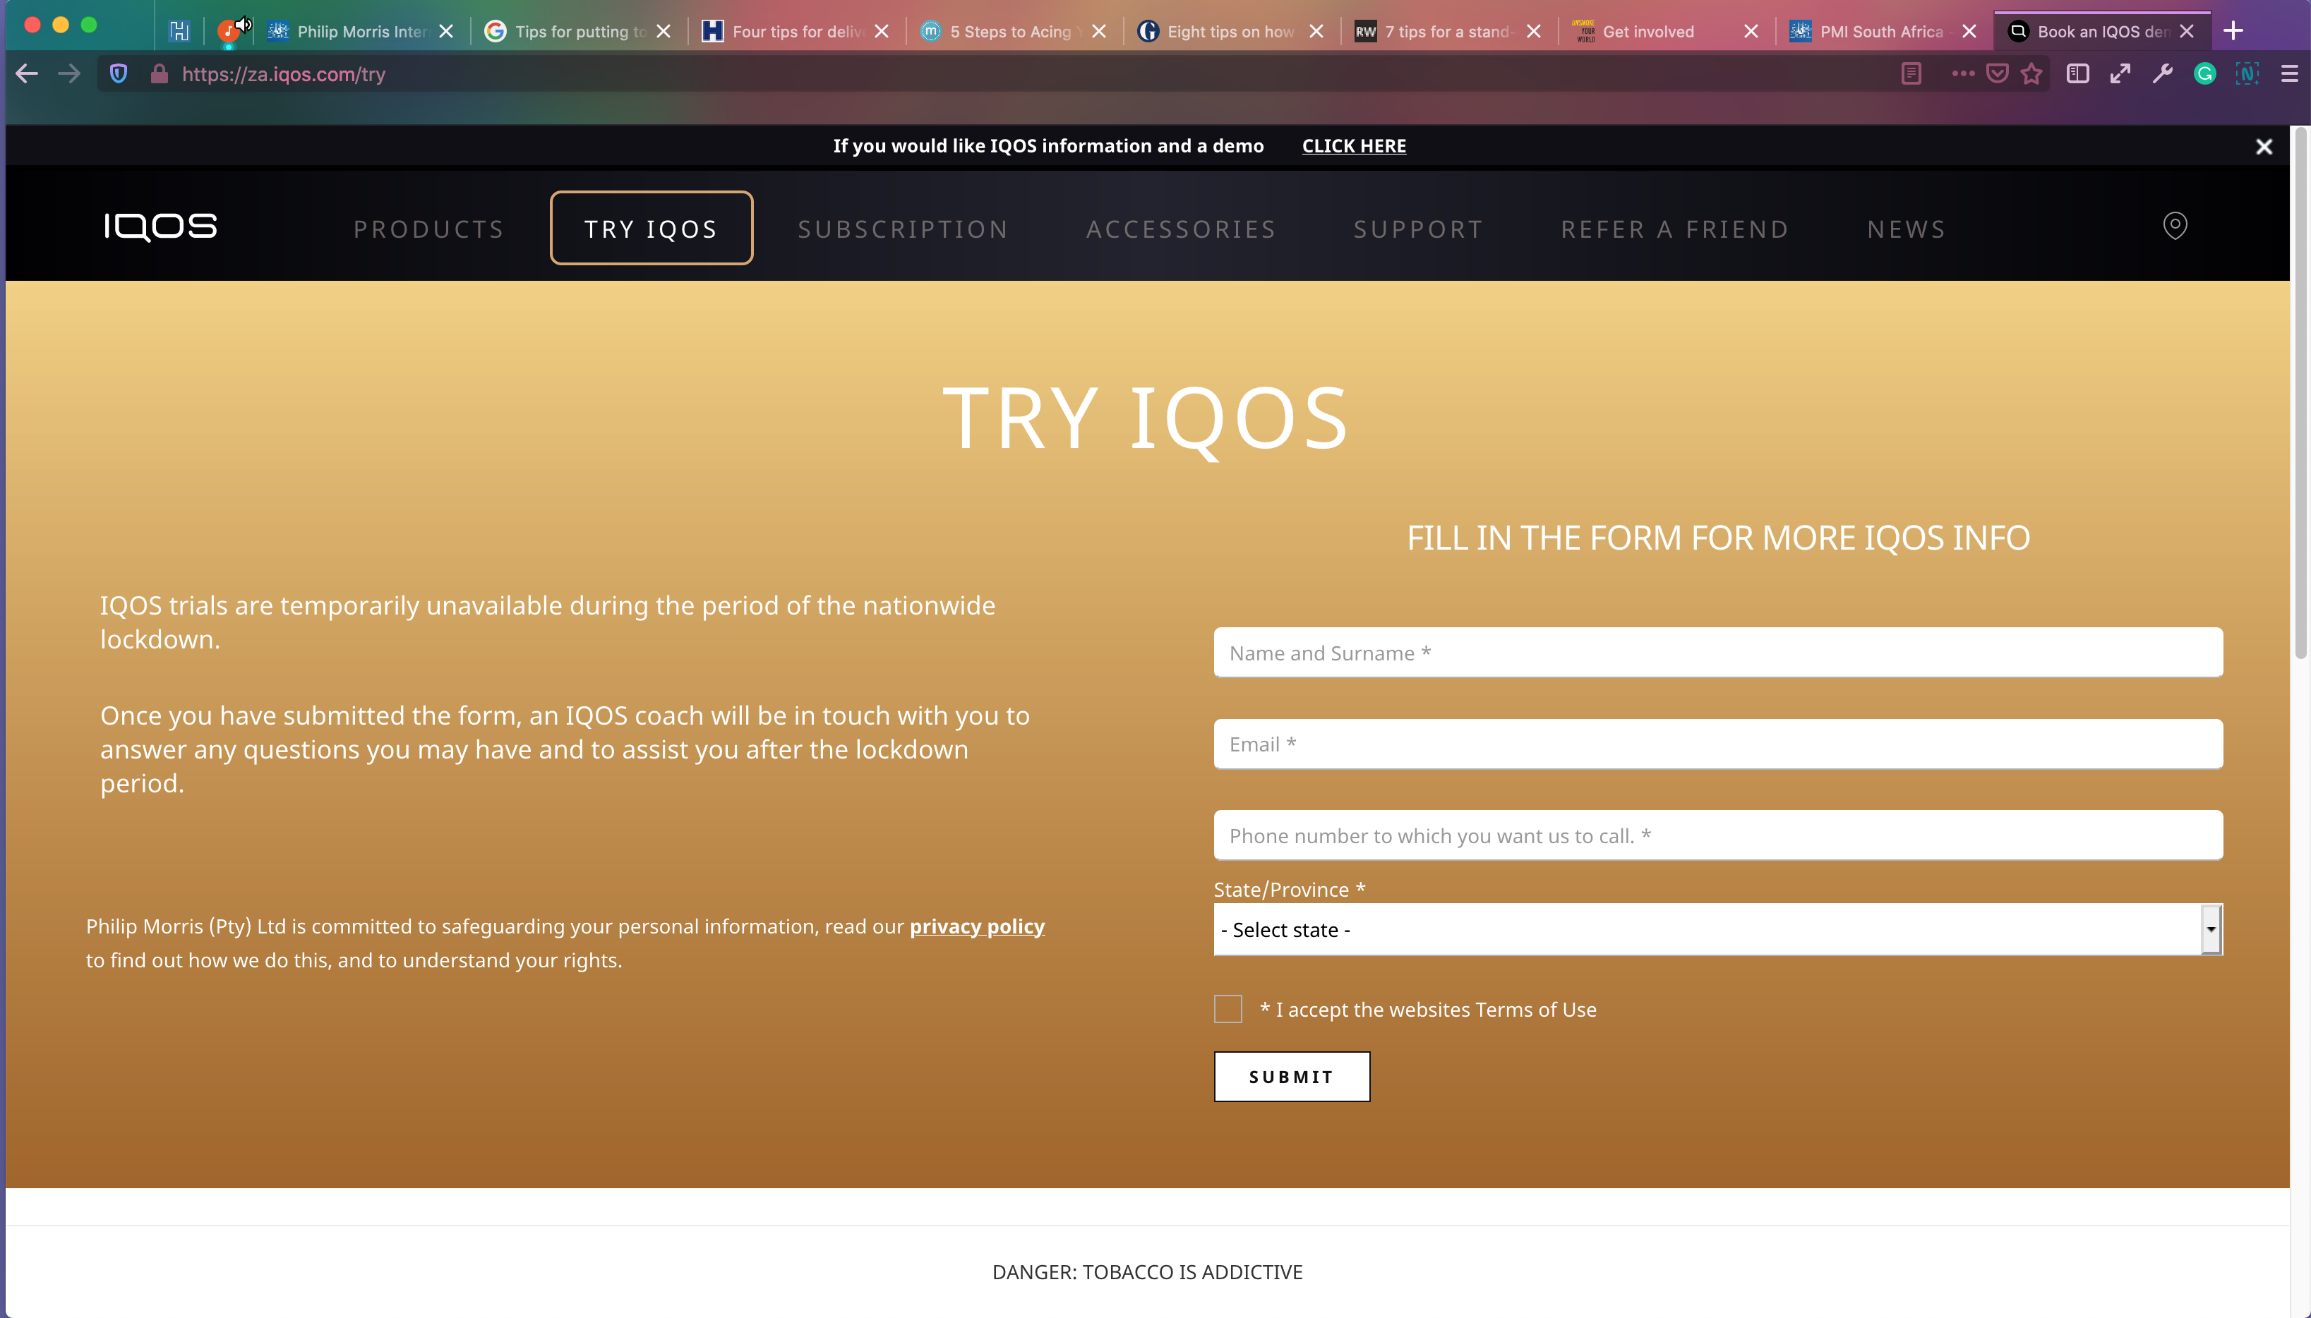
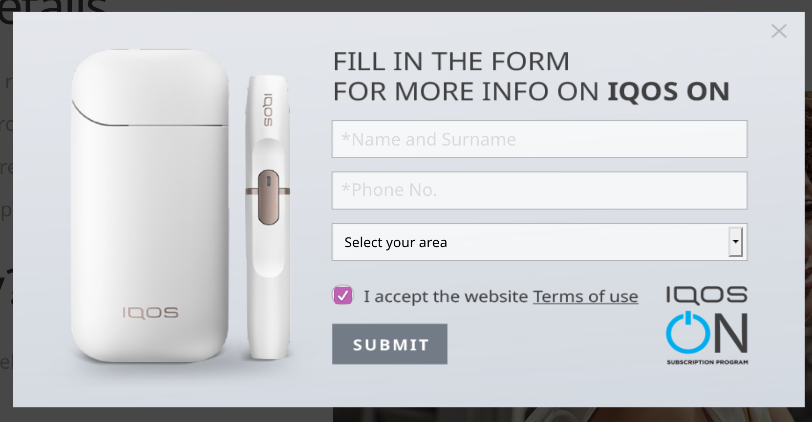
Overview of Software Development Life Cycle
Web Forms
The journey from prospecting, to purchase, to loyalty and beyond is definitely not a straight path.
Rather it's filled with many many twists and turns, hills, valleys etc.
We use the data we get from web forms, in Salesforce, to engage with the customer around uncertainties, suggest alternatives, encourage return visits, and guide our customers into deeper, long-term attachments.
Analogue Product

Slide 6
Overview of Software Development Life Cycle
Technicalities
Description
Outcomes/Benefits
Front-End Development
Create New Forms
Test Campaign Workflows
Commit CSS and HTML changes to codebase.
Design Emails and Landing Page
Current CSS might be aligned to old browser standards, Emails might break across devices
mobile first approach will mean higher conversions
1
Our Product
Document Salesforce Processes
Map out Sales Processes digital marketing process
Introduce Real Time Reporting for Sales & Marketing
2
Clear process for cleaning leads
Stop duplication of work across teams
Have one central place to manage leads – Salesforce
Develop email digital marketing strategy. Marketing and other company functional departments must speak to each other. How can we report conversion across these orgs.?
Real-time reporting
Establish goals to inform website project
Save time by automation
Attribution modelling will track conversion from different sources. Use of UTM tags is very important
Establish Reporting Goals
3
Analogue Product
Notes:
I made a submission recently did anybody get the email?

Slide 7
Overview of Software Development Life Cycle
User Personas
Wealthy
3
Adult White Male
Anti Smoking Activist: Money pits
Cigar Smokers : Quick wins
Purchasing Power
4
African Adult Male
6
Walter Madzonga
5
African Adult Female
2
Adult White Female
7
Roscoe Hartogh
Tobacco Smoker: Low hanging fruit
Poor
1
Drinkers
Negative
Positive
Attitude Towards Tobacco
Analogue Product

Slide 8
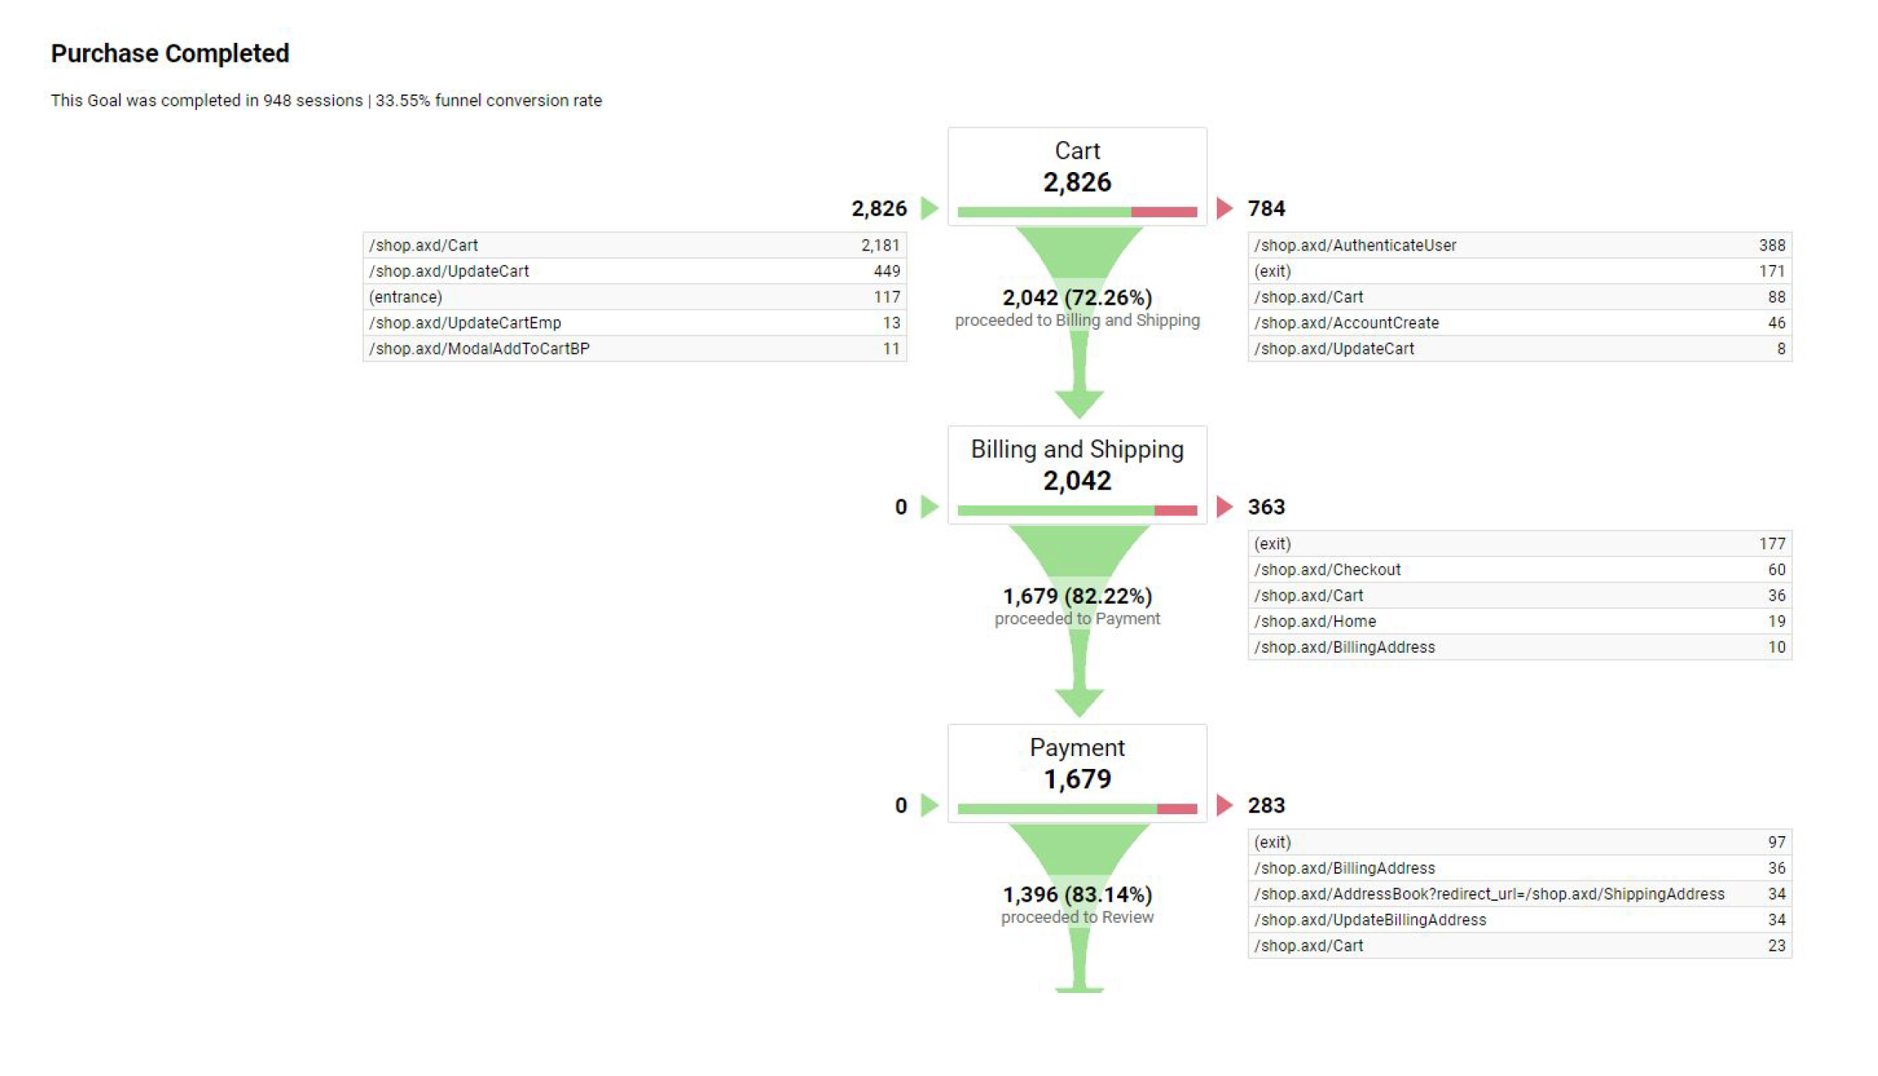
Overview of Software Development Life Cycle
Using Google Analytics
Our Product
Analogue Product

Slide 9
Overview of Software Development Life Cycle
Types of Email Transactions
So we use Salesforce too to implement the various email and SMS campaigns. I will administrator the components, Build rich html mobile-friendly mail sand use other tactics to achieve our campaign Goals: Perhaps we might consider:
Set up a series of event reminder emails each week each with unique content,
Reduce uncertainty in the marketing by providing thought leadership,
We must always seek to encourage action and engagement from our SalesForce contacts and Leads. In this context a 10% increase in order caused by a innovative email marketing campaign, might be be very important if the marketing team was motivating for more digital marketing budget.
Make Offer
Survey
Event Invitation
Transactional Mail
Welcome Mail
Our Product
Analogue Product

Slide 10

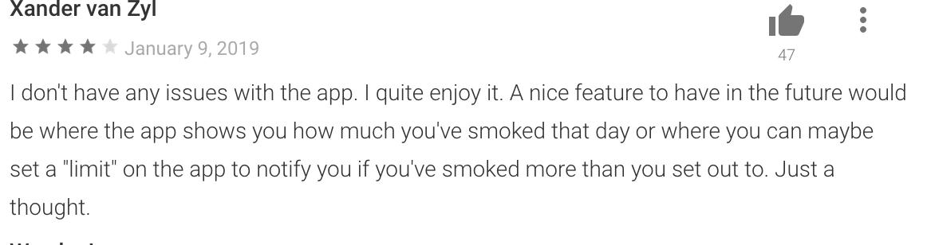
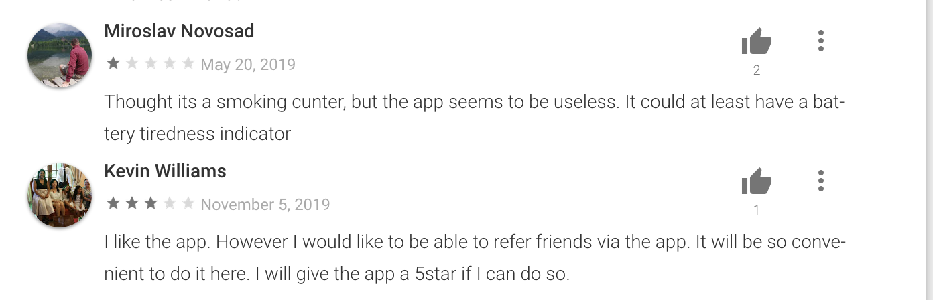
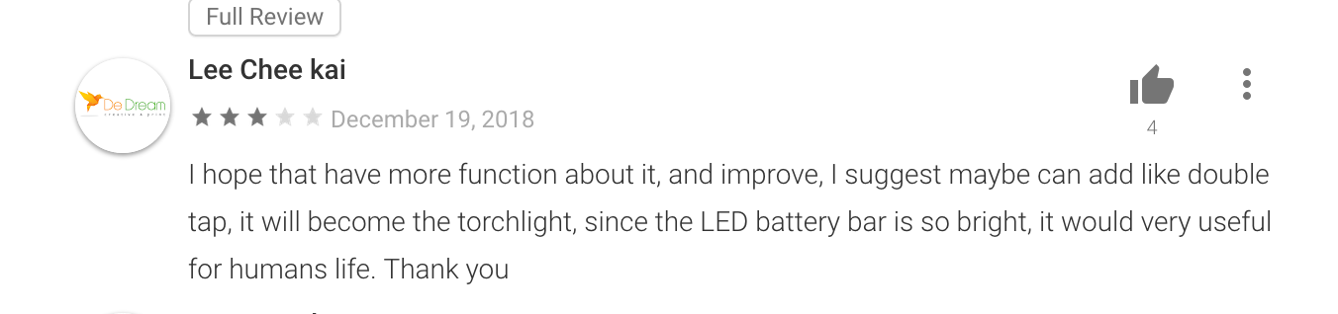
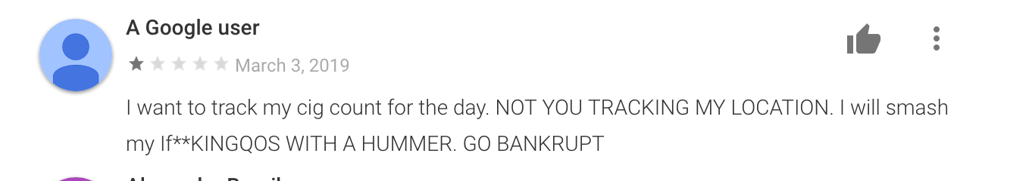
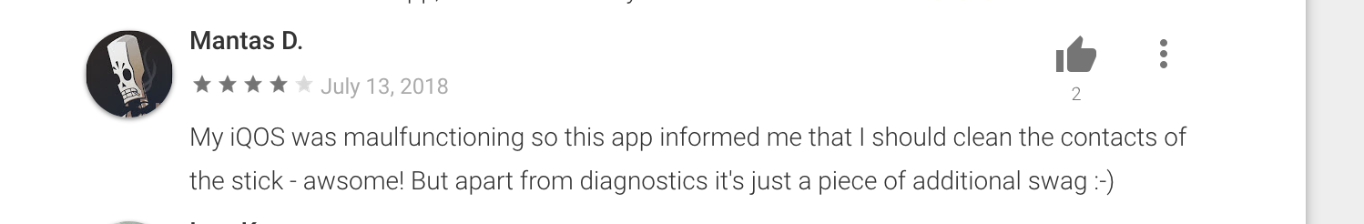
Feedback from the market
Product Feature Mix

